Slide 1

Kentucky “Healthy at Work”
Guidelines for Opening Places of Worship
during COVID-19
summarized from
https://govstatus.egov.com/ky-healthy-at-work#MinimumRequirements
www.pastordaniel.net

Slide 2
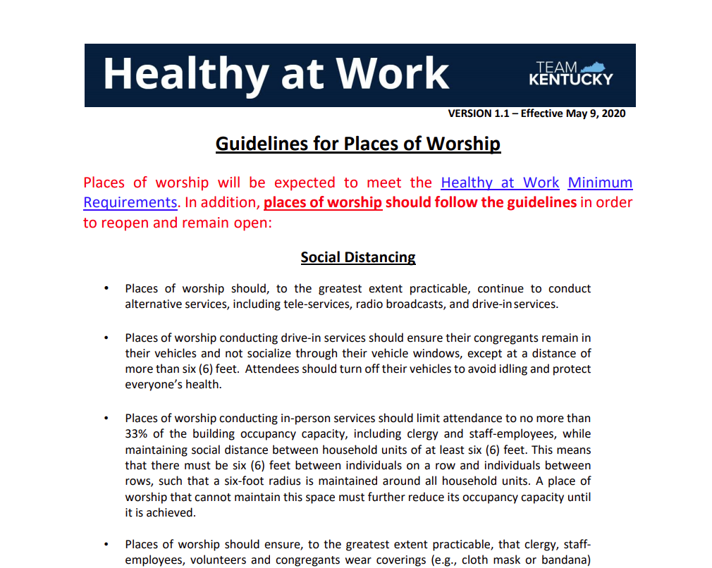

Slide 3
Summary
Houses of worship were scheduled to begin reopening May 20, but can now open effective May 9 due to Federal Court Ruling.
State Health Guidelines for reopening churches include:
  Social Distancing
  Personal Protective Equipment Requirements
  Cleaning and Disinfecting Requirements
  Training and Safety Requirements

Slide 4
www.pastordaniel.net
Re-Opening Churches
With Pastor Daniel’s
“Not Politically Correct”
Interpretation
Bullet points are intended for understanding and interpretation of the guidelines.
These should not be considered as the official guideline. Also, I am not a lawyer.
Graphics are intended for humor and interest. It is not my intention to offend or stereotype any
individual or group of people.

Slide 5

Social Distancing Requirements
Keep going to
church online
Leaders – Keep online
services going!
Places of worship should, to the greatest extent practicable, continue to conduct
alternative services, including tele-services, radio broadcasts, and drive-in services.

Slide 6

Social Distancing Requirements
If you drive in, stay in your car.
Places of worship conducting drive-in services should ensure their congregants remain in
their vehicles and not socialize through their vehicle windows, except at a distance of
more than six (6) feet. Attendees should turn off their vehicles to avoid idling and protect
everyone’s health.

Slide 7

Social Distancing Requirements
Sit 6-feet apart (from people from other households)
Don’t pack the house! (limit 33% capacity)
Places of worship conducting in-person services should limit attendance to no more than
33% of the building occupancy capacity, including clergy and staff-employees, while
maintaining social distance between household units of at least six (6) feet. This means
that there must be six (6) feet between individuals on a row and individuals between
rows, such that a six-foot radius is maintained around all household units. A place of
worship that cannot maintain this space must further reduce its occupancy capacity until
it is achieved.

Slide 8

Social Distancing Requirements
Wear A Mask!
Places of worship should ensure, to the greatest extent practicable, that clergy, staff-
employees, volunteers and congregants wear coverings (e.g., cloth mask or bandana)
over their mouths and noses while attending services

Slide 9

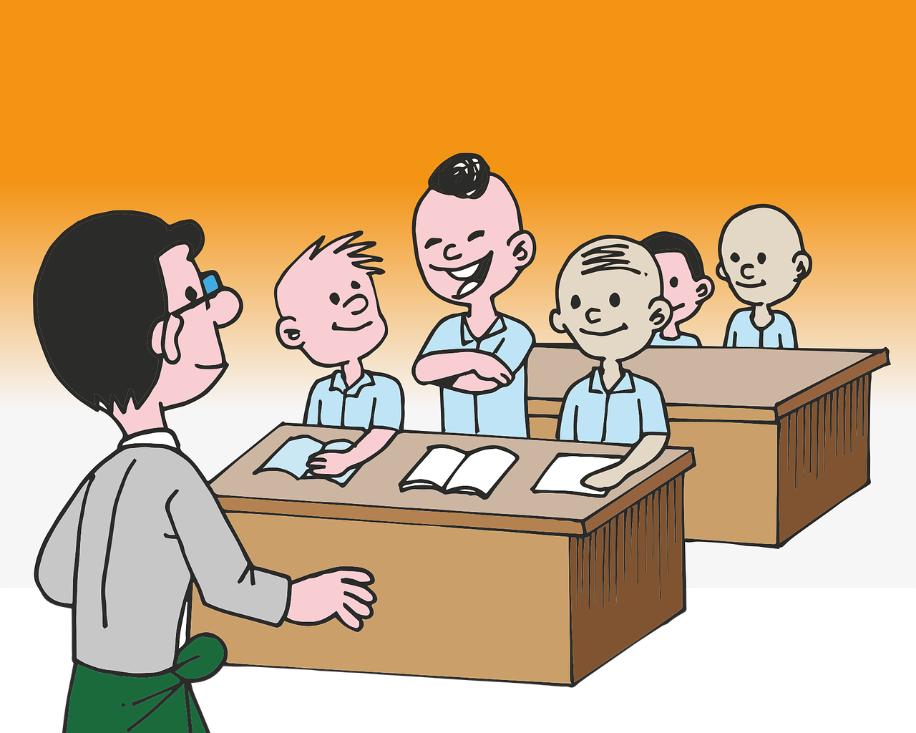
Social Distancing Requirements
No Children’s / Youth Classes until June 15
Places of worship should wait to reopen youth services (including, but not limited to,
Sunday schools) until childcare services have reopened on June 15, 2020. Once they
reopen, youth services should follow the requirements posted for childcare services.

Slide 10

Social Distancing Requirements
No Congregational Singing
Places of worship should avoid congregational or choir singing during services, as doing
creates a higher risk of spreading infectious particles. Houses of worship should consider
alternatives to congregational singing, including by playing pre-recorded or live
instrumental music (e.g. pianos and guitars - no wind instruments) during services.

Slide 11
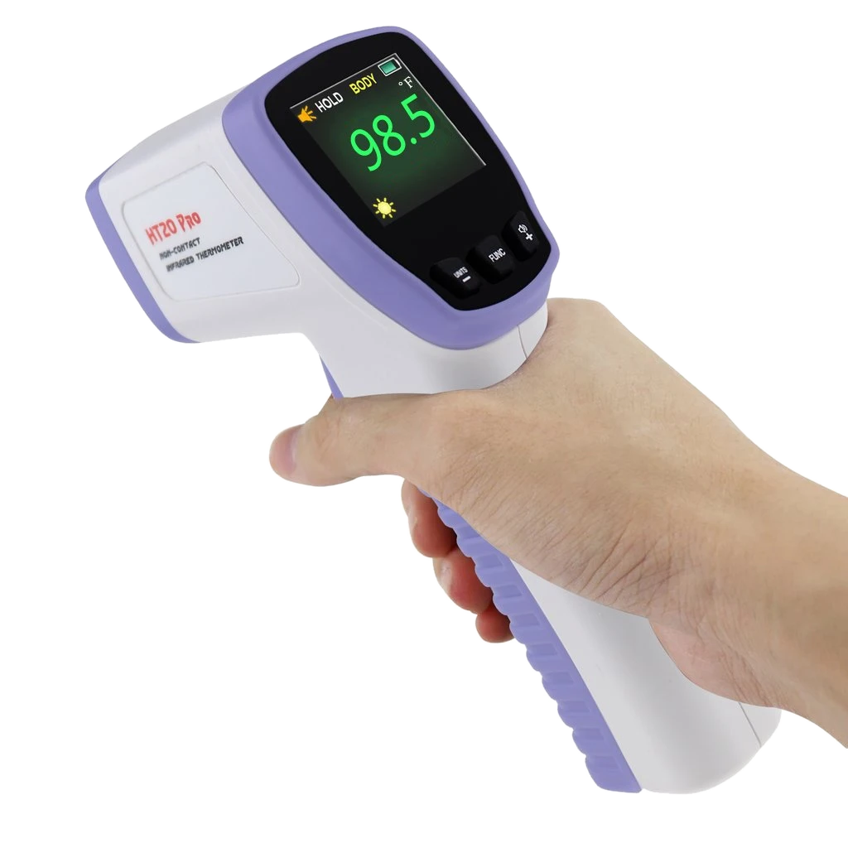
Social Distancing Requirements
Take Temperatures
Places of worship should consider taking congregants’ temperatures and asking about
signs of illness before admitting them into the place of worship. If they do take
temperatures, they should consider using a non-contact thermometer or thermal imager.
If a place of worship must use a standard oral/aural thermometer, consider having the
congregant take their own temperature and relay the information to maintain social
distancing and sanitize the thermometer after each use.

Slide 12
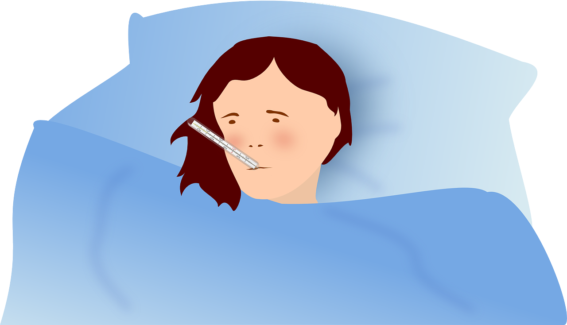
Social Distancing Requirements
Send sick people home
Places of worship should not allow individuals with elevated temperatures (100.5 degrees
Fahrenheit or above) or signs of illness (coughing, shortness of breath, sneezing) to attend
in-person services. Houses of worship should direct those having symptoms of COVID-19,
as well as people who have had close contact with a person who has symptoms like dry
cough, chest tightness, and/or fever, to refrain from participating in any aspect of in-
person services. Places of worship should encourage symptomatic persons to stay at
home or seek immediate medical care or want to be tested.

Slide 13


Social Distancing Requirements
Have greeters point people to masks and bulletins
Places of worship should use greeters to direct congregants to available masks and
bulletins. Greeters should be masked, maintain social distancing, and consider wearing
gloves.

Slide 14

Social Distancing Requirements
Post Signs
Communicate Changes
Places of worship should display markers and signage in the sanctuary/meeting space to
guide social distancing.
Places of worship should communicate with the congregation often and with clarity and
transparency. Prepare the congregation for worship and for the changes that are
occurring in procedures due to the national health crisis

Slide 15

Social Distancing Requirements
Use Restrooms
one-at-a-time
Disinfect restrooms
after each use
Places of worship making restrooms available must ensure restrooms are only used by
one person at a time and all portions that are regularly touched (e.g., door, sink, and toilet
handles) are appropriately disinfected after each use.

Slide 16

Social Distancing Requirements
Provide Hand Sanitizer,
etc
Places of worship conducting in-person services must, to the greatest extent practicable,
provide hand sanitizer, handwashing facilities, tissues, and waste baskets in convenient
locations.

Slide 17

Social Distancing Requirements
No eating, no potluck,
no communion
Places of worship should not provide communal food or beverages to clergy, staff-
employees, volunteers, or congregants.

Slide 18

Social Distancing Requirements
Close off gatherings
spaces
Places of worship should restrict access to common areas, to the greatest extent practicable, in
order to maximize social distancing and reduce congregating. These common areas include, but
are not limited to, foyers, lobbies, vending areas, community and multi-purpose rooms, and
event spaces.

Slide 19

Social Distancing Requirements
No Handshakes
No Hugs
Because of the requirement to socially distance at least six (6) feet apart, places of
worship should refrain from the practice of handshaking, handholding, or hugging.

Slide 20
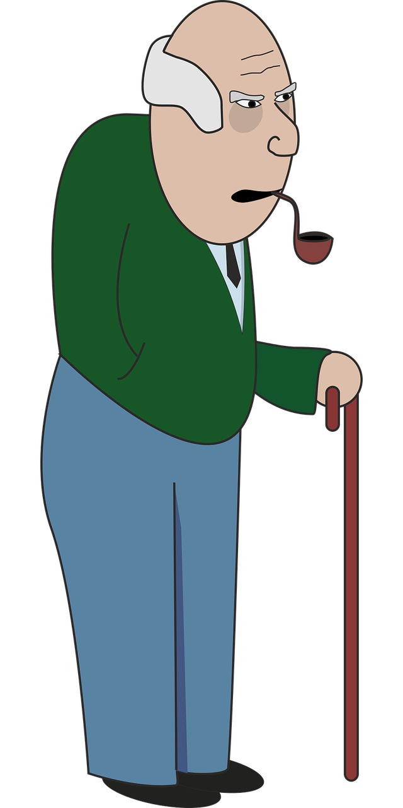
Social Distancing Requirements
No attendees who are at high-risk from COVID-19
Or, provide alternate times for high-risk individuals
Places of worship should encourage those at higher risk for severe illness
per CDC guidelines not to attend in-person services. These guidelines are
available at: https://www.cdc.gov/coronavirus/2019-ncov/faq.html#Higher-Risk.
Instead, places of worship should, to the greatest extent practicable, provide services that are not in-person, including tele-services, drive-in services, and/or radio services for those individuals. If a house of worship is unable to provide alternative services, they should, to the greatest extent practicable, implement hours where service can be safely provided to congregants at higher risk for severe illness.

Slide 21
Personal Protective Equipment Requirements
Wear A Mask!
Places of worship should ensure, to the greatest extent practicable, that clergy, staff-
employees, volunteers and congregants wear coverings (e.g., cloth mask or bandana)
over their mouths and noses while attending services

Slide 22

Cleaning and Disinfecting Requirements
Properly clean and sanitize facilities.
Clean surfaces people touch.
Use bleach & alcohol-based cleaners
Places of worship must ensure facilities are properly cleaned and ventilated.
Places of worship must ensure cleaning and sanitation of frequently touched surfaces
with appropriate disinfectants. Appropriate disinfectants include EPA registered
household disinfectants, diluted household bleach solution, and alcohol solutions
containing at least 60% alcohol. Places of worship must establish a cleaning and
disinfecting process that follows CDC guidelines when any individual is identified,
suspected, or confirmed as COVID-19 positive

Slide 23

Cleaning and Disinfecting Requirements
Don’t sweep or blow surfaces – it could spread the virus!
Places of worship, as appropriate, must ensure they do not use cleaning procedures that
could re-aerosolize infectious particles. This includes, but is not limited to, avoiding
practices such as dry sweeping or use of high-pressure streams of air, water, or cleaning
chemicals.

Slide 24
Training and Safety Requirements
Post Signs
Communicate Changes
Places of worship should ensure appropriate signage is posted throughout their facilities
to inform clergy, staff-employees, and congregants about good hygiene and new
practices.

Slide 25

Training and Safety Requirements
Learn not to touch
your face.
Places of worship should ensure clergy, staff-employees, volunteers, and congregants are
instructed to avoid touching their faces, including their eyes, noses, and mouths,
particularly until after they have thoroughly washed their hands upon completing work
and/or removing PPE, to the greatest extent practicable.

Slide 26
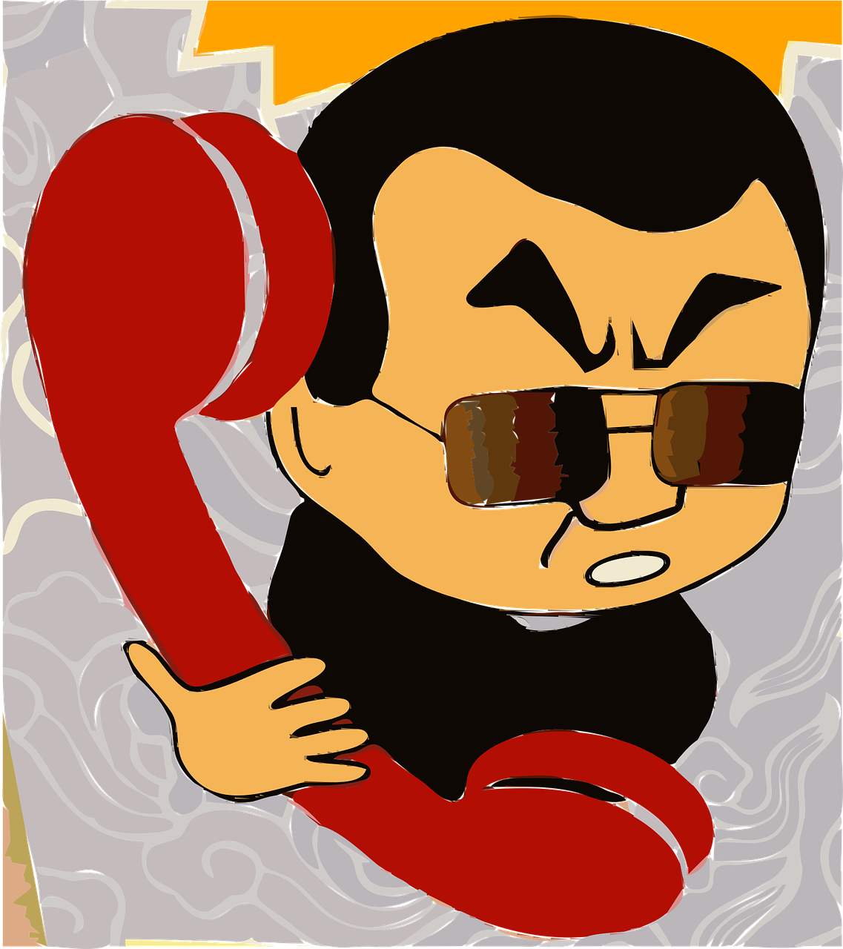
Training and Safety Requirements
Communicate Concerns
Places of worship should ensure clergy, staff-employees, volunteers, and congregants are
informed that they may identify and communicate potential improvements and/or
concerns in order to reduce potential risk of exposure.

